Slide 1
What you don't know about SQL?

Slide 2

SQL Actuality

Slide 3

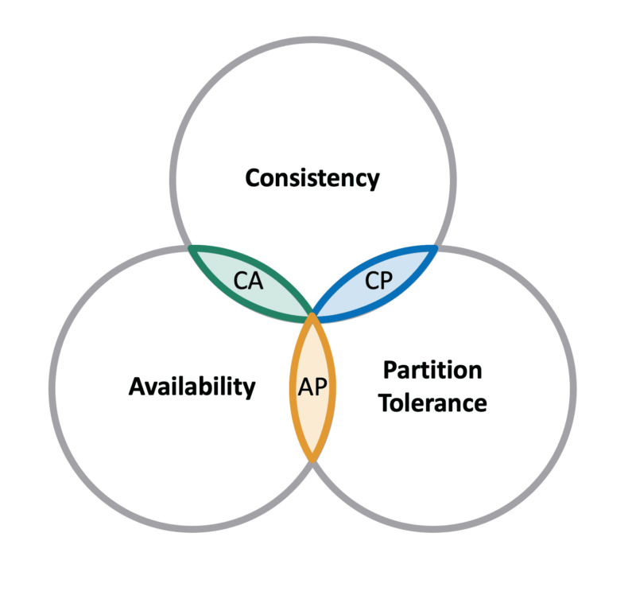

CAP theorem
It is impossible for a distributed data store( information is stored on more than one node) to simultaneously provide more than two out of the following three guarantees:
Computer scientist
Eric Brewer

Slide 4

CAP theorem
Consistency: Every read receives the most recent write or an error
Availability: Every request receives a (non-error) response, constant read and write access
Partition tolerance: The system works despite partitions in the network(messages could be dropped/delayed)
Magical Fantasy
Land

Slide 5
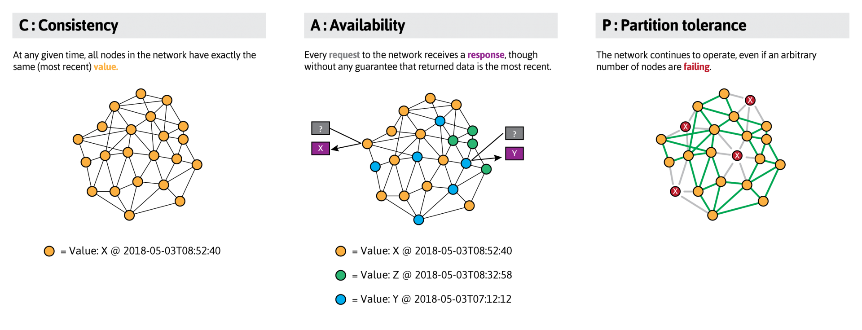
CAP theorem

Slide 6
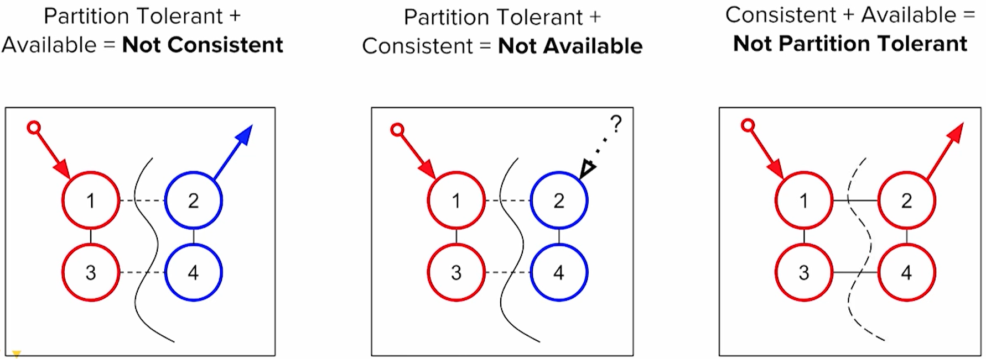
Why the CAP theorem is true?

Slide 7
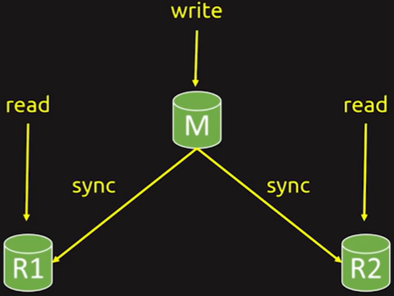
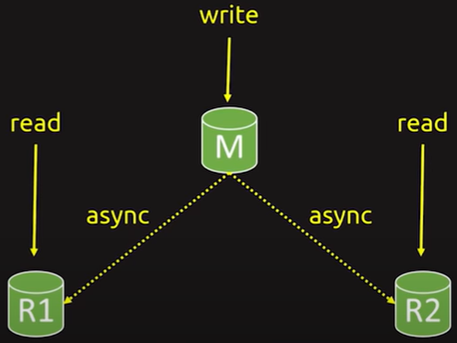
Latency/Consistency

Slide 8
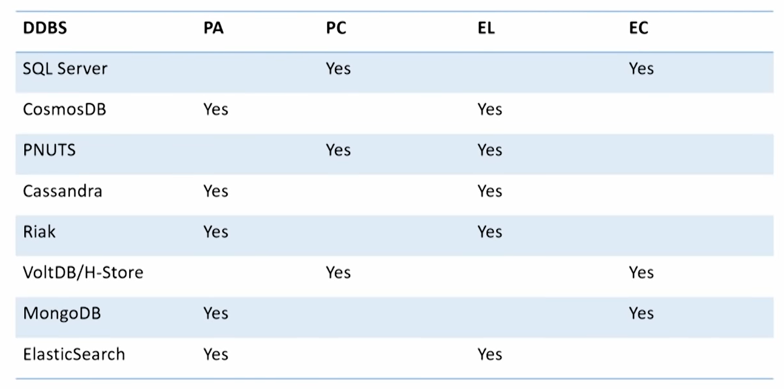
Theorem PAC-ELC
EС – latency + consistency
EL – latency + consistency –> eventual consistency

Slide 9
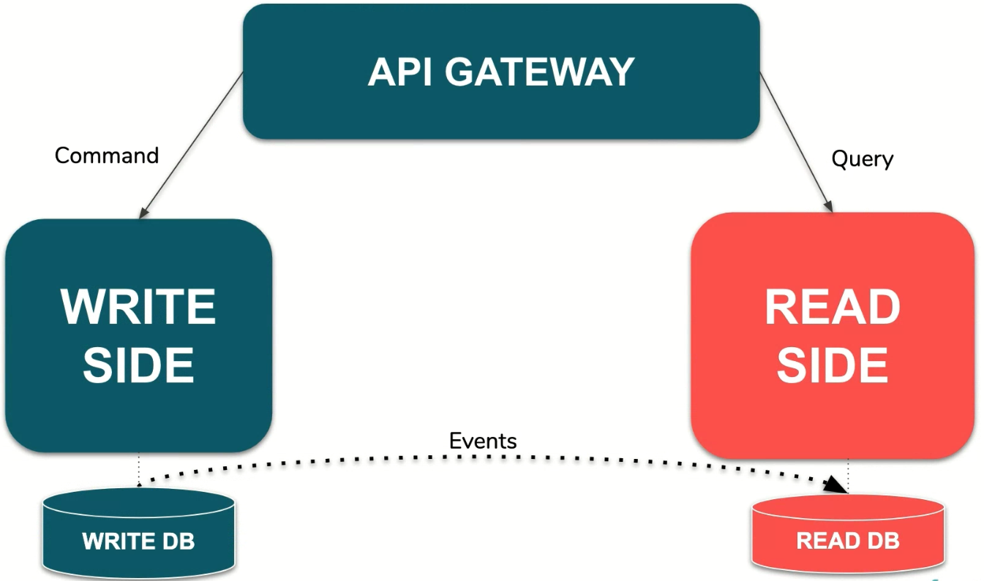
Dividing DB for reading/writing

Slide 10
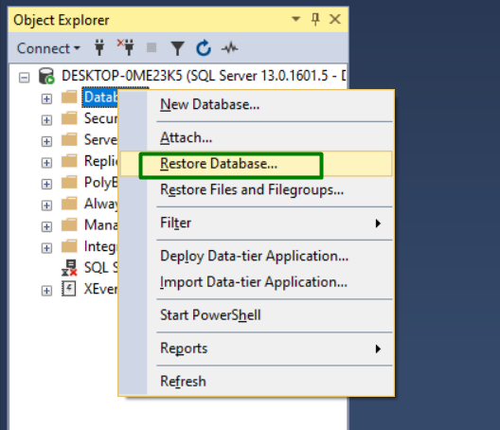
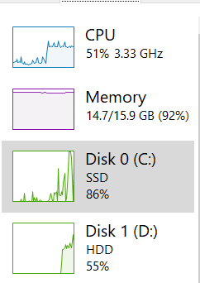
Finding the problem
AdventureWorks

Slide 11
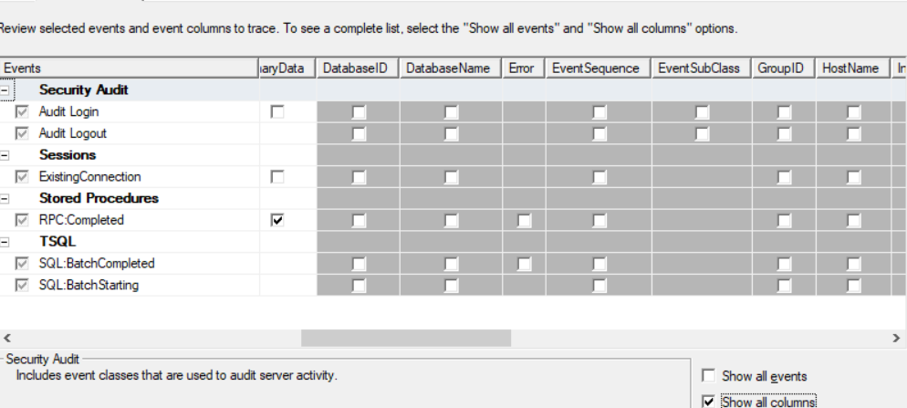
Finding the problem

Slide 12
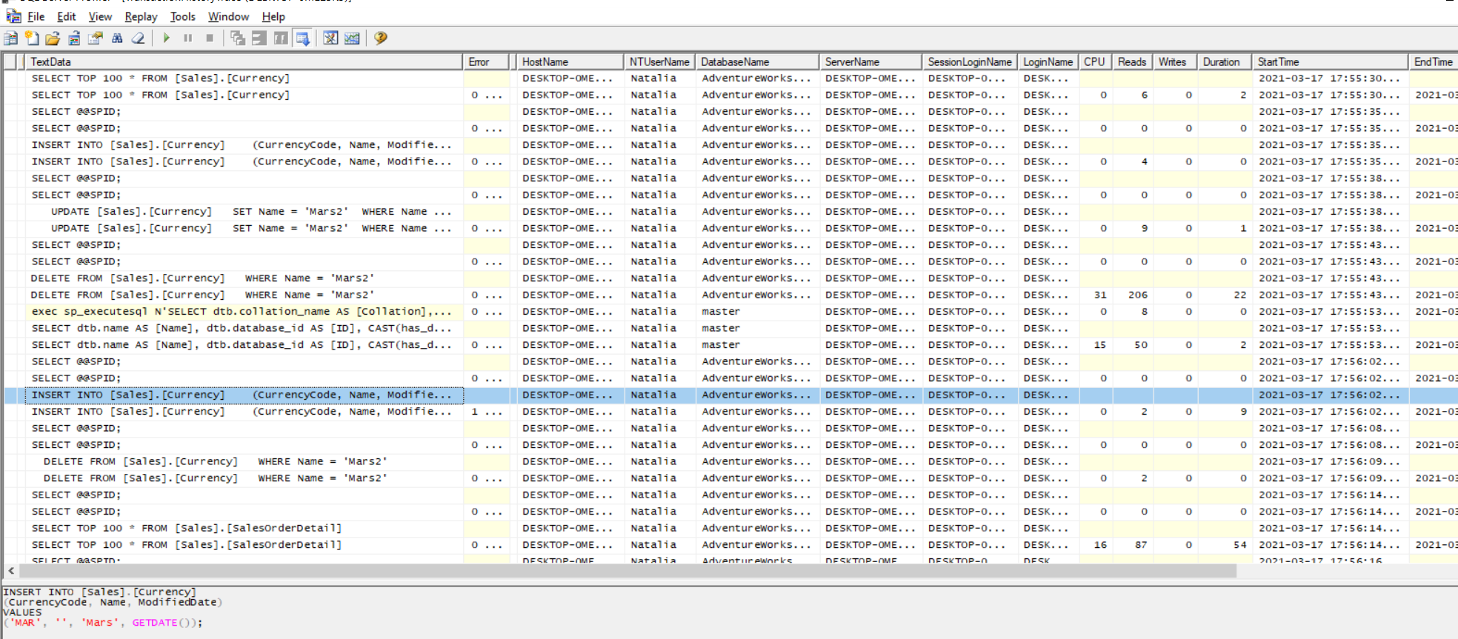
Finding the problem

Slide 13
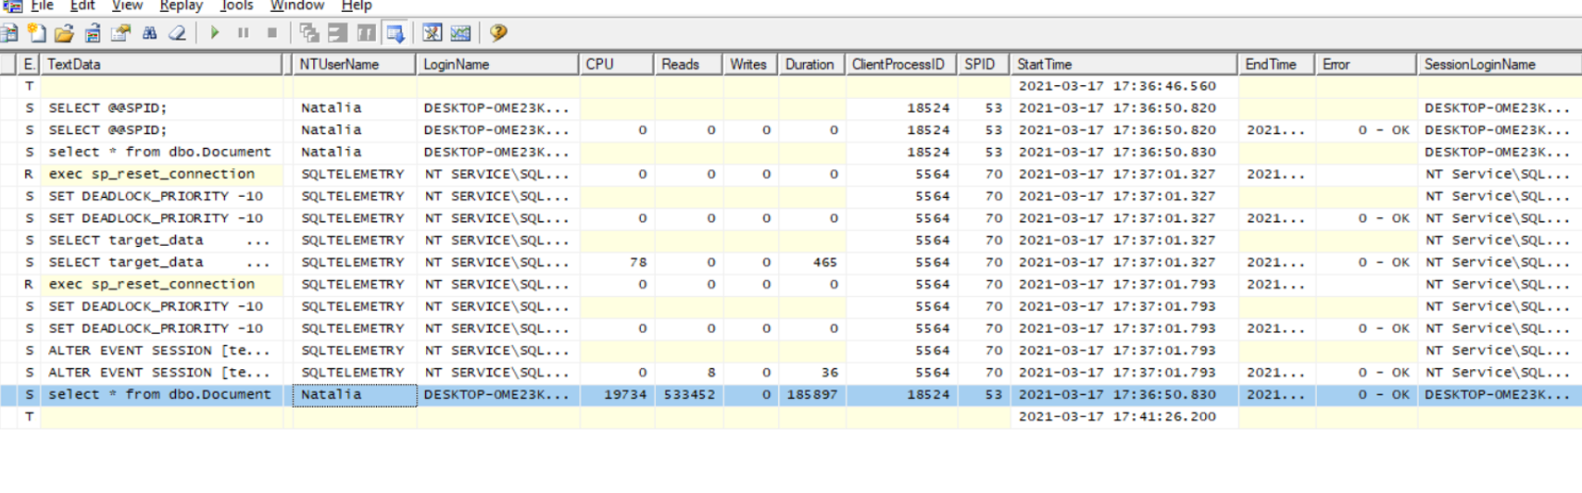
Finding the problem

Slide 14
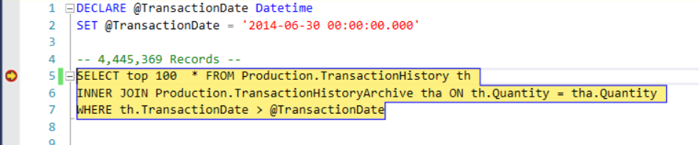
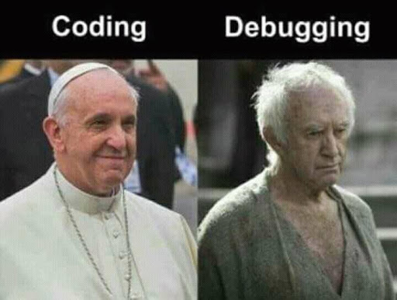
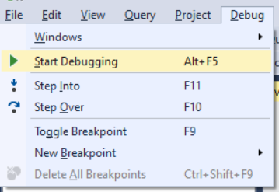
Finding the problem
Don’t hesitate to use debugger!

Slide 15
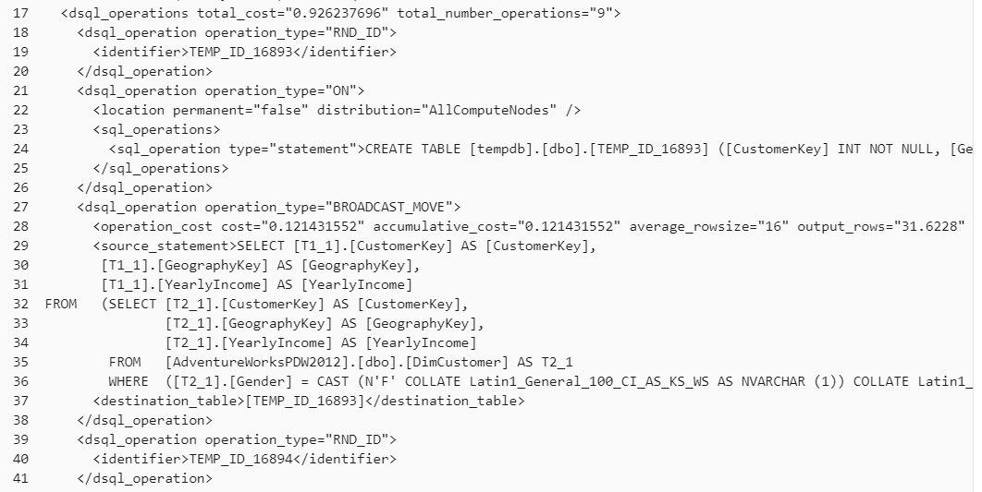
Solving the problem
EXPLAIN WITH_RECOMMENDATIONS indicate what the command would do without actually doing them (git … --dry-run)

Slide 16
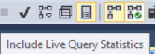
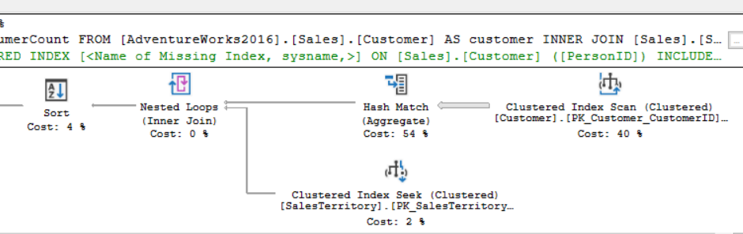
Solving the problem
Execution Plans

Slide 17
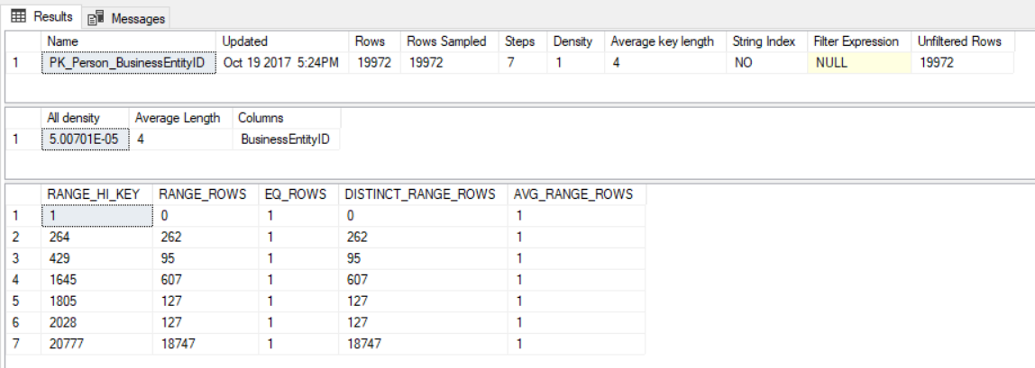
Solving the problem
Execution Plans
DBCC SHOW_STATISTICS
('Person.Person','PK_Person_BusinessEntityID')
Cardinality Estimators
(assumptions how one variable depends correlation, distribution, and more.)

Slide 18
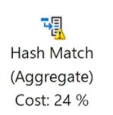
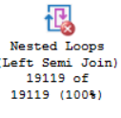
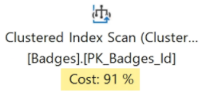
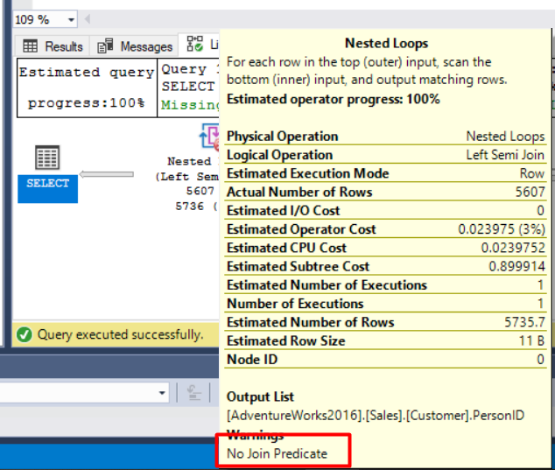
Solving the problem
SELECT customer.PersonID
FROM [AdventureWorks2016].[Sales].[Customer]
AS customer
INNER JOIN [Sales].[SalesTerritory] AS territory
ON customer.TerritoryID = territory.TerritoryID and territory.[Group] = 'Europe'
-- and PersonID in (SELECT PersonID FROM Person.Person where PersonType = 'EM')
WHERE PersonID IS NOT NULL

Slide 19
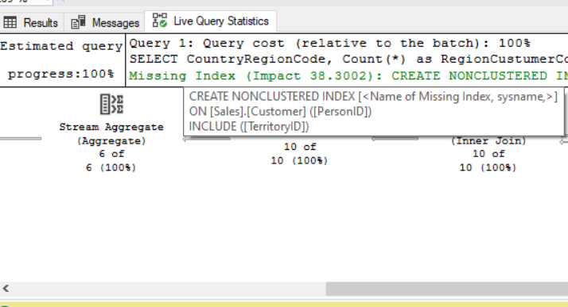
Solving the problem
SELECT CountryRegionCode, Count(*) as RegionCustumerCount
FROM [AdventureWorks2016].[Sales].[Customer] AS customer
INNER JOIN [Sales].[SalesTerritory] AS territory
ON customer.TerritoryID = territory.TerritoryID
WHERE PersonID IS NOT NULL
GROUP BY CountryRegionCode
HAVING Count(*) > 1000
ORDER BY CountryRegionCode DESC

Slide 20
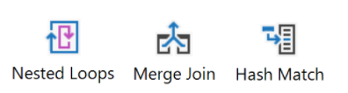
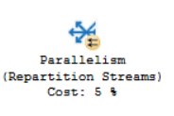
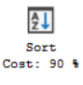
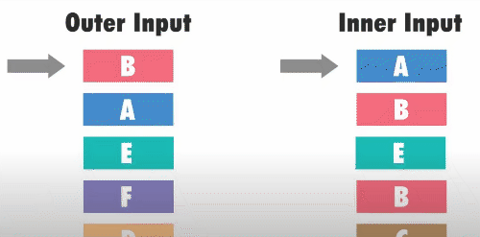
Solving the problem
Commonly Troublesome Operators

Slide 21
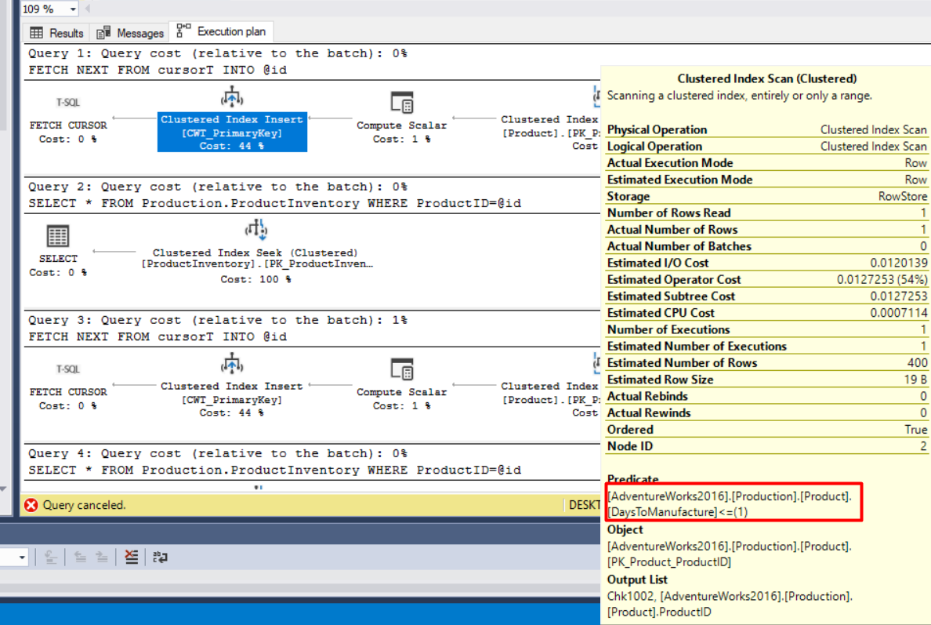
Solving the problem
Cursor Example
USE AdventureWorks2016
GO
DECLARE @id int
DECLARE cursorT CURSOR
FOR
SELECT ProductId
FROM AdventureWorks2016.Production.Product
WHERE DaysToManufacture <= 1
OPEN cursorT
FETCH NEXT FROM cursorT INTO @id
WHILE @@FETCH_STATUS = 0
BEGIN
SELECT * FROM Production.ProductInventory
WHERE ProductID=@id
FETCH NEXT FROM cursorT INTO @id
END
CLOSE cursorT
DEALLOCATE cursorT

Slide 22
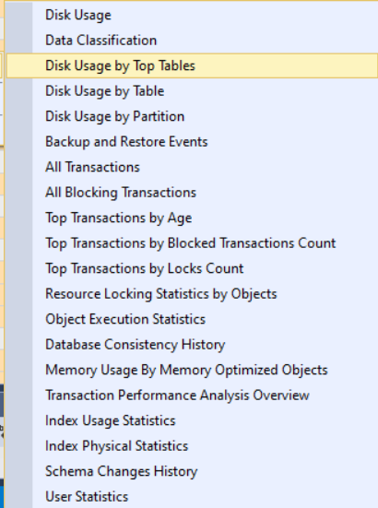
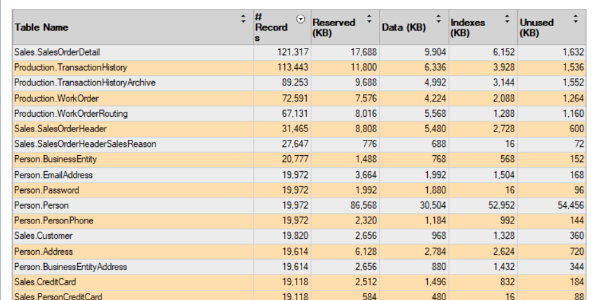
Solving the problem
Don’t hesitate to use reports!

Slide 23
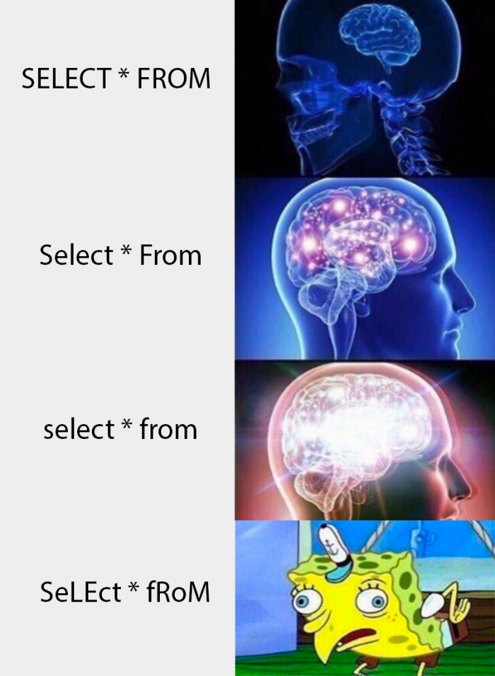

Most common mistakes in SQL queries
Misspelling Commands
Forgetting Brackets (AND OR) and Quotes
Omitting/Skipping Table Aliases
Filtering a date range using BETWEEN
BETWEEN only for Inclusive(включно!) Ranges

Slide 24
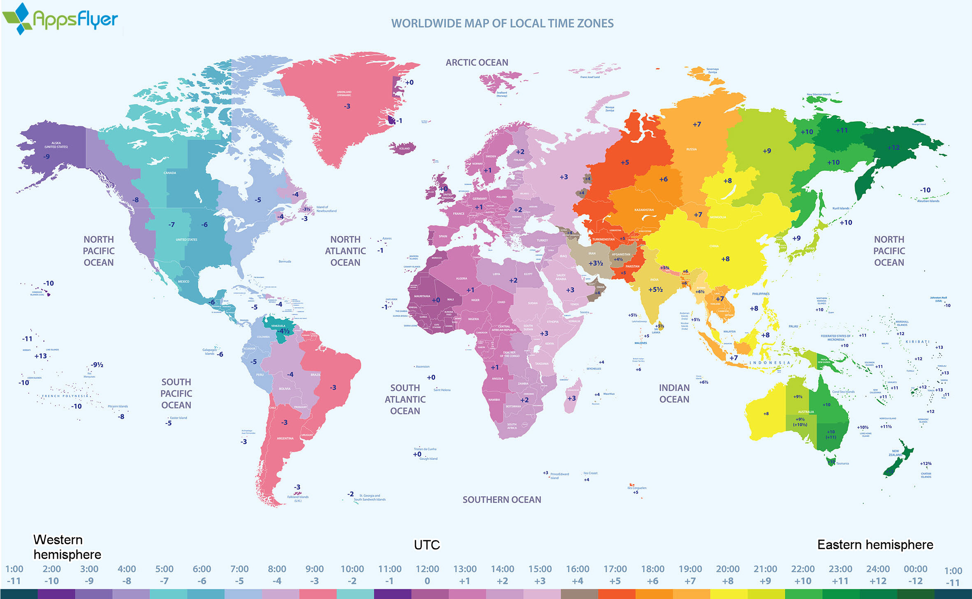
Most common mistakes in SQL queries

Slide 25
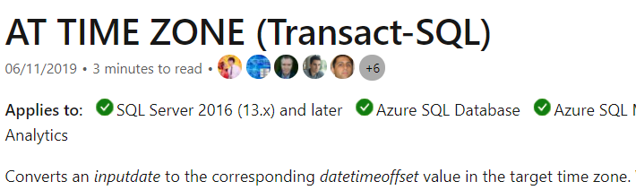

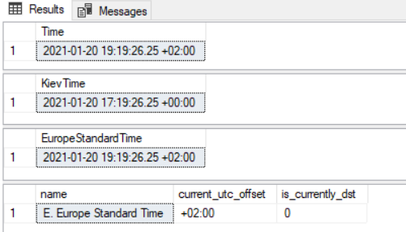
Most common mistakes in SQL queries
-- UTC – Coordinated Universal Time
SELECT TOP 1 [ModifiedOn][dbo].[ApplicationViewPreferences]
SELECT TOP 1 [ModifiedOn] AT TIME ZONE 'UTC' AS KievTime
FROM [dbo].[ApplicationViewPreferences]
SELECT TOP 1 [ModifiedOn] AT TIME ZONE
'E. Europe Standard Time' AS EuropeStandardTime
FROM [dbo].[ApplicationViewPreferences]
SELECT * FROM sys.time_zone_info
WHERE name like '%E. Europe Standard Time%'
Offset value

Slide 26
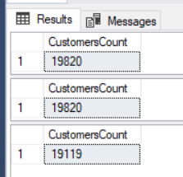
Most common mistakes in SQL queries
COUNT(*) returns the number of items in a group. This includes NULL values and duplicates.
COUNT(ALL expression) evaluates expression for each row in a group, and returns the number of nonnull values.
SELECT COUNT(*) as CustomersCount
FROM [AdventureWorks2016].[Sales].[Customer]
-- PersonID couldn't be NULL
SELECT COUNT(CustomerID) as CustomersCount
FROM [AdventureWorks2016].[Sales].[Customer]
-- PersonID could be NULL
SELECT COUNT(PersonID) as CustomersCount
FROM [AdventureWorks2016].[Sales].[Customer]

Slide 27
Most common mistakes in SQL queries
DECLARE @Dep_Id INT
DECLARE @Emp_Id INT
DECLARE EmpCursor CURSOR FOR
SELECT dep_id, id FROM employee
OPEN EmpCursor
FETCH NEXT FROM EmpCursor INTO @Dep_Id, @Emp_Id
DECLARE @DepName NVARCHAR(50)
WHILE(@@FETCH_STATUS = 0)
BEGIN
SELECT @DepName = dep_name FROM department where id = @Dep_Id
IF(@DepName = 'Sales')
BEGIN
UPDATE employee SET salary = (salary * 1.1) WHERE id = @Emp_Id
END
ELSE IF(@DepName = 'HR')
BEGIN
UPDATE employee SET salary = (salary * 1.2) WHERE id = @Emp_Id
END
IF(@DepName = 'IT')
BEGIN
UPDATE employee SET salary = (salary * 1.5) WHERE id = @Emp_Id
END
FETCH NEXT FROM EmpCursor INTO @Dep_Id, @Emp_Id
END
CLOSE EmpCursor
DEALLOCATE EmpCursor
USE company;
UPDATE employee
SET salary = CASE
WHEN dep_name = 'Sales' THEN (salary * 1.1)
WHEN dep_name = 'HR' THEN (salary * 1.2)
WHEN dep_name = 'IT' THEN (salary * 1.5)
END
FROM employee
JOIN department ON department.id = employee.dep_id
WHERE (dep_name = 'Sales' OR dep_name = 'HR' OR dep_name = 'IT')

Slide 28
Most common mistakes in SQL queries
Invalid statement order
SELECT CountryRegionCode, Count(*) as RegionCustumerCount
FROM [AdventureWorks2016].[Sales].[Customer] AS customer
INNER JOIN [Sales].[SalesTerritory] AS territory
ON customer.TerritoryID = territory.TerritoryID
WHERE PersonID IS NOT NULL
GROUP BY CountryRegionCode
HAVING Count(*) > 1000
ORDER BY CountryRegionCode DESC

Slide 29
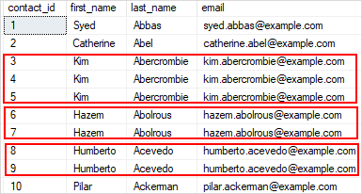
Most common mistakes in SQL queries
Ignoring constraints(uniqueness, cascade deleting an so on)
Indexes based on queries which you will execute
Put indexes to each column bad idea(they change on Insert Update Delete)
DROP #Temp table

Slide 30
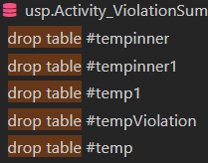
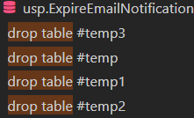
Real-life examples

Slide 31
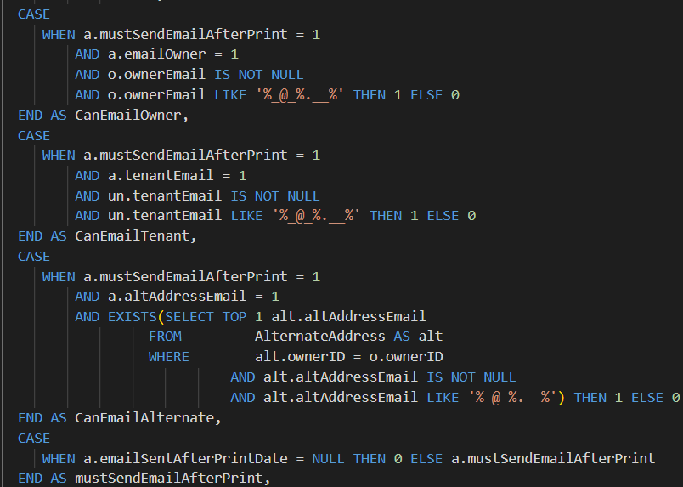
Real-life examples

Slide 32
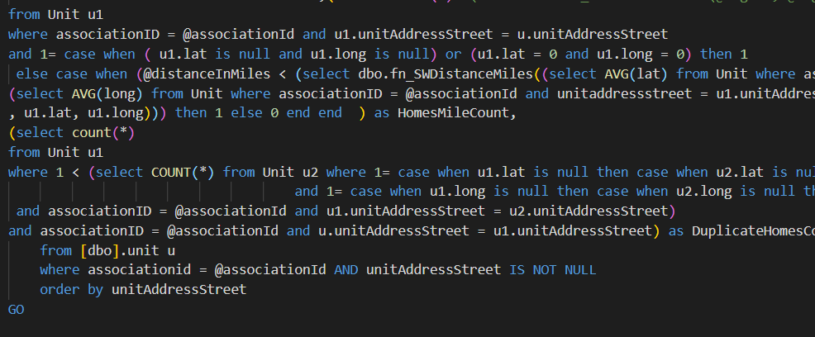
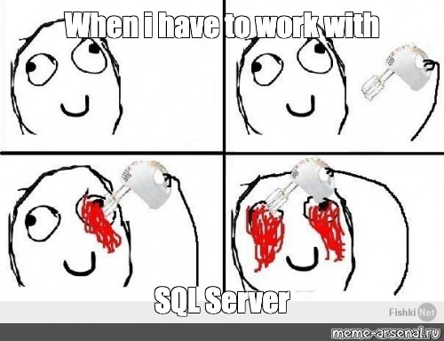
Real-life examples

Slide 33
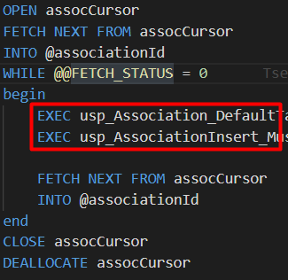
Real-life examples

Slide 34
Thank you! Questions?
Links: Explanation plans

